Slide 1


Slide 2
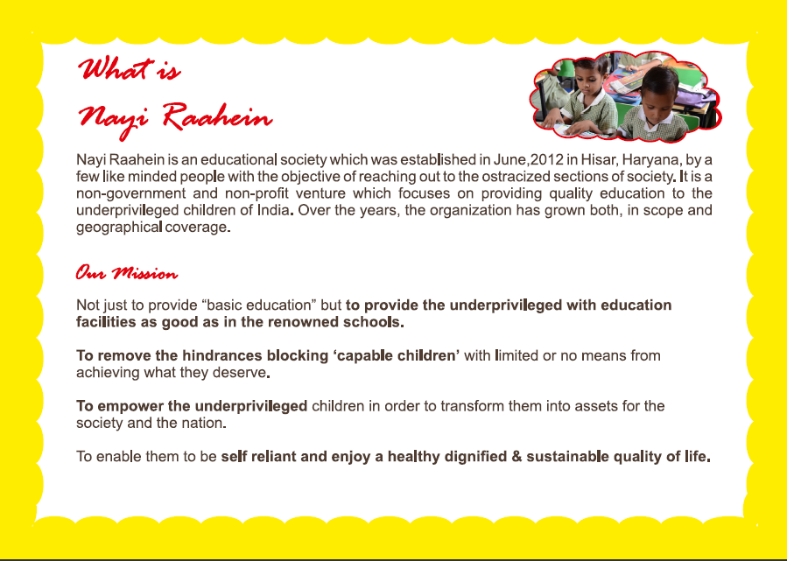

Slide 3
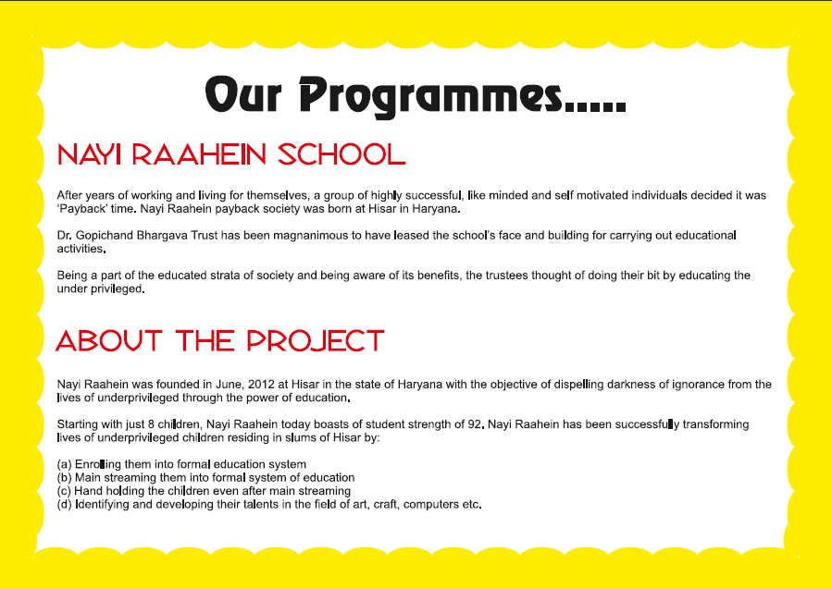

Slide 4
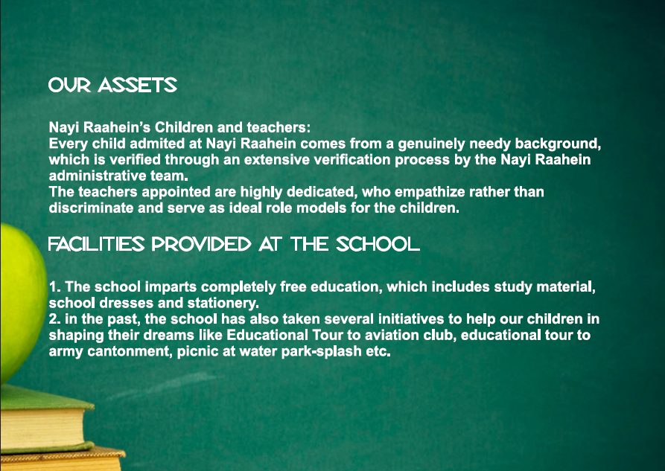

Slide 5
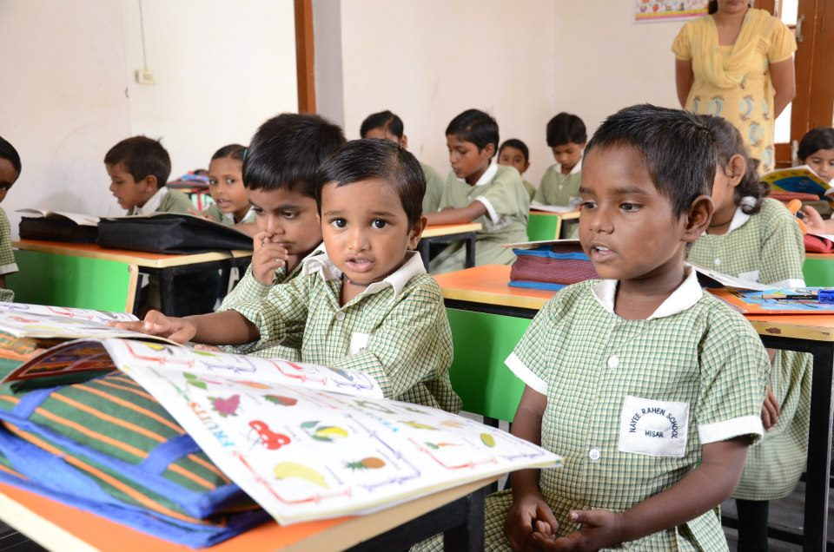

Slide 6

PROJECT आरम्भ
(अंधेरे से उजाले की और…)

Slide 7

PROJECT आरम्भ, is a scrap collection campaign, in which the School going children from upper and middle classes are encouraged to bring newspapers of the previous date from their homes and submit to their class teachers.
With the fund from this scrap, we will be empowering the children from the underpriveleged section of the society, by providing them quality education.

Slide 8

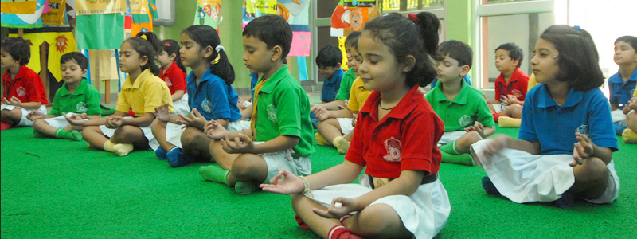
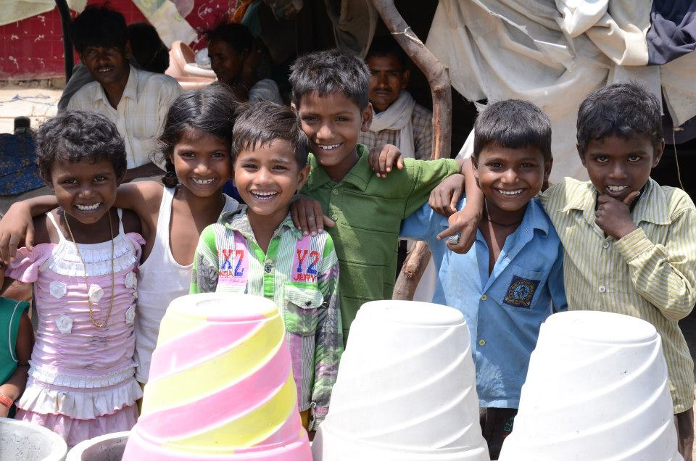
WHY आरम्भ?
Two sections of the society and their needs:
PRIVELEGED
UNDERPRIVELEGED
Empathy
Sympathy
Life Skills
Food, shelter, clothing
Education
Care
Positive Parenting
Health Check ups
This project keeps both these sections in mind and treats them accordingly.

Slide 9
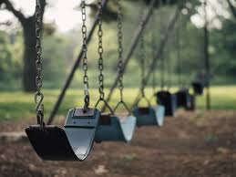
How can
this be
Achieved?

Slide 10
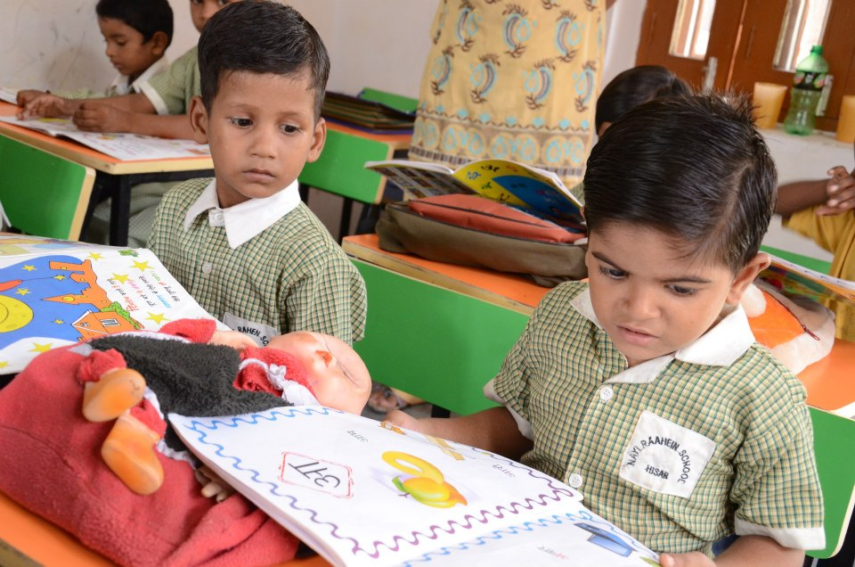
OUR ASSOCIATION WITH SCHOOLS
By associating schools, conducting seminars and volunteer registration programmes for collecting ‘RADDI’.
A hierarchy of active volunteers will be made in the schools, For eg. A Head Boy and a Head Girl will represent the Project आरम्भ, and a Class Monitor for every class in every School.
Conducting a city meet once a month, of the Head Boys and the Head Girls of all the associated schools in the city.
A rolling trophy will be awarded to the school with the highest percentage of involved volunteers(who donate) and their class photograph will be published in most of the popular local papers.
Data will be constantly managed of every student donating newspapers or other material and this will be constantly uploaded on the website.

Slide 11

FUNCTIONING OF
THE PROJECT आरम्भ
DATA MANAGEMENT: The data of every student contributing will be managed according to school and address.
COLLECTION CENTRES: Approximately 10 common collection centres will be made in different locations of Hisar covering the entire city.
The information of students will be with the Head Boy and the Head Girl of the respective school, they will further pass it on to the class monitors, and hence to the students via the monitors.
DOOR TO DOOR CAMPAIGNING: At the locations of collection centres, street plays will be performed two days before collection to encourage people to participate in the project and spread awareness.
MASS INVOLVEMENT: Local societies, kitties, senior citizens, etc. can volunteerily be involved.
PROJECT MANAGEMENT: Students across universities and colleges will be thoroughly managing the entire project.

Slide 12
TRANSPARENCY OF
PROJECT आरम्भ
RECEIPT: The students contributing raddi(scrap) will be given a receipt as per their contribution.
WEBSITE: The information like the names of students, amount of collection,etc. will be uploaded on the website.
LIST: A list of contributing students and their schoolwise collection will be given to every school.

Slide 13
POST PROJECT आरम्भ
PLAN A
NAYI RAAHEIN
Upgrading and maintaining the school.
expand the current infrastructure and facilities to cater to the education of over 300 children in the coming years
PLAN B
SUPER 100
Finding the 100 best talent among the underpriveleged through a series of test rounds, and giving them the best teachers to compete with the national talent.
PLAN C
Giving aid to other NGOs
We will be providing Teachers and books to NGOs that educate the underprivileged children.

Slide 14

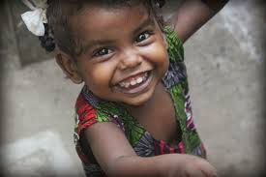
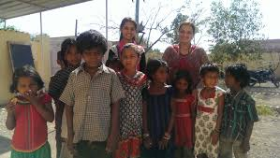
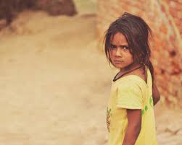
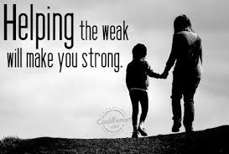
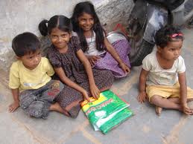

Slide 15

Are
we all
TOGETHER?

