Slide 1

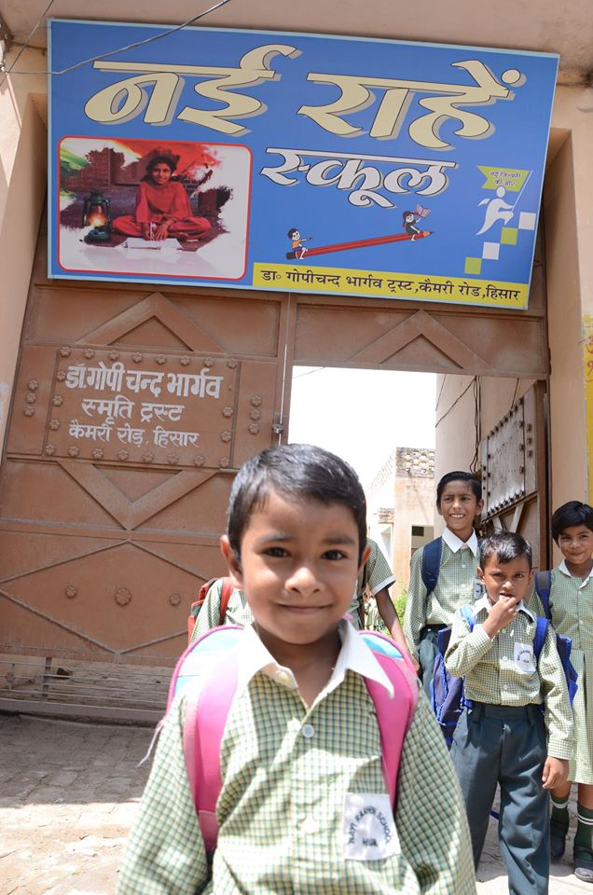
An initiative:
To bring about a difference in the lives of the
under privileged children.
To bring smiles
because EVERY CHILD DESERVES A CHANCE

Slide 2

Our mission
To not just provide 'basic education' but to provide the underprivileged children with education facilities as good as in the renowned schools
We are committed to finding, developing and supporting India's brightest from amongst the 'underprivileged' children.

Slide 3
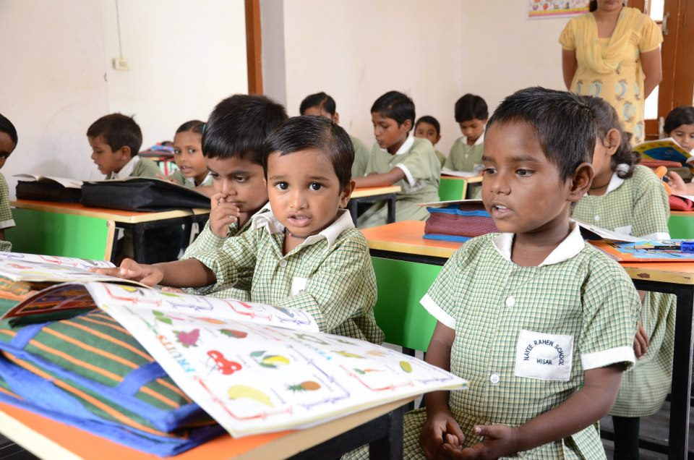

Slide 4

PROJECT
PRAARAMBH

Slide 5

To make Nayi Raahein
A self-sustainable model
PROJECT PRAARAMBH, is a donation programme, where we will be collecting old newpapers, books etc. from students across various schools in the city.

Slide 6

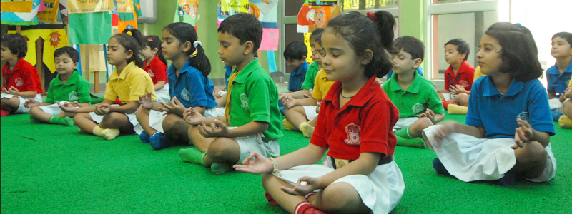
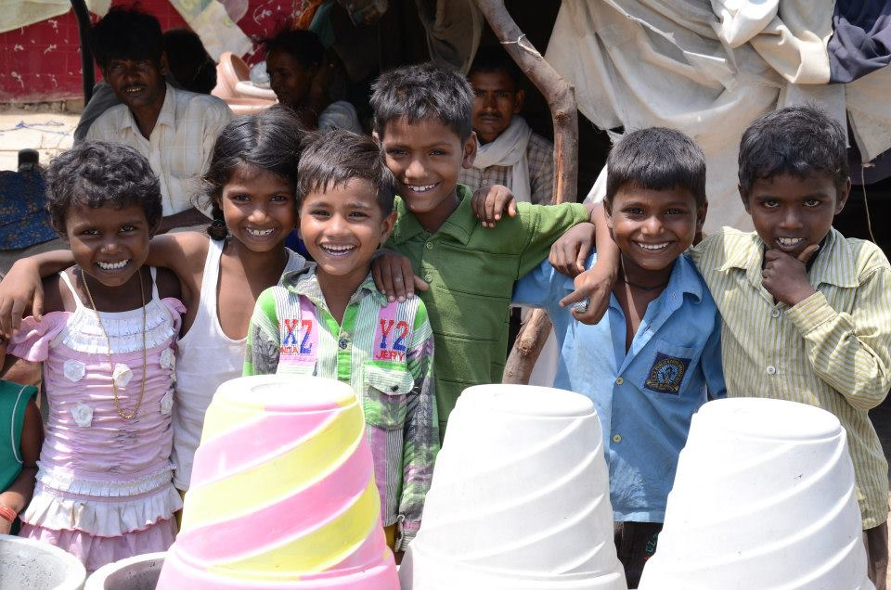
WHY PRAARAMBH?
Two sections of the society and their needs:
PRIVELEGED
UNDERPRIVELEGED
Empathy
Sympathy
Life Skills
Food, shelter, clothing
Education
Care
Positive Parenting
Health Check ups
This project keeps both these sections in mind and treats them accordingly.

Slide 7
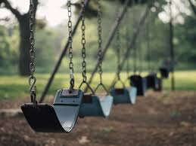
How can
this be
Achieved?

Slide 8
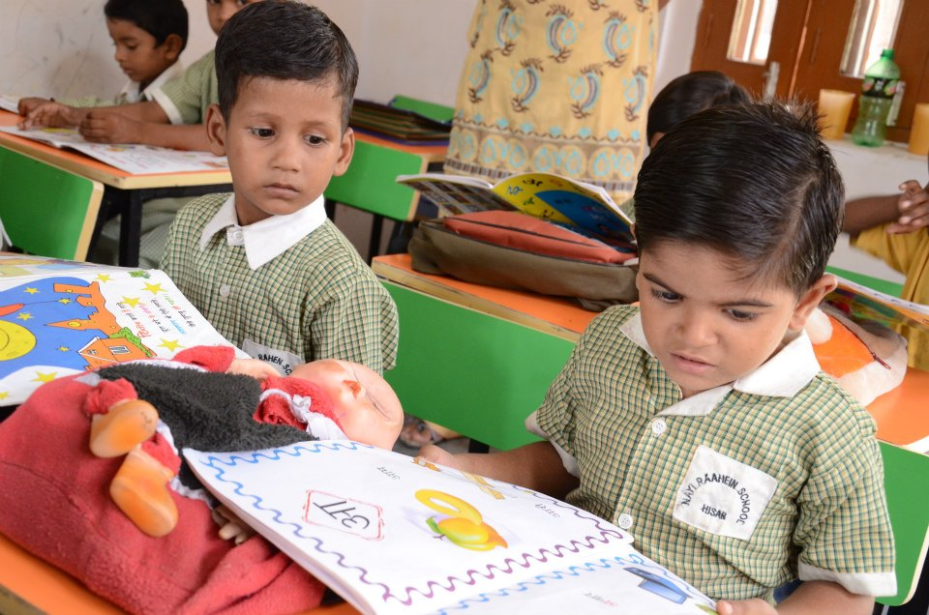
By associating schools, conducting seminars and volunteer registration programmes for collecting ‘RADDI’. A hierarchy of active volunteers will be made in the schools, For eg. A Head Boy and a Head Girl of the Project Praarambh Club,and a Class Monitor for every class in every School.
Conducting a city meet once a month, of the Head Boys and the Head Girls of all the associated schools in the city. A rolling trophy will be awarded to the school with maximum donation and their class photograph will be published in most of the popular local papers.
Data will be constantly managed of every student donating newspapers or other material and this will be constantly uploaded on the website.
Street Plays will be carried out in the city at different locations to campaign the project.

Slide 9

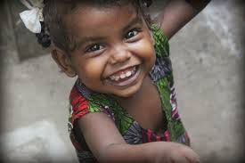
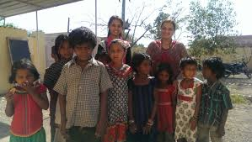
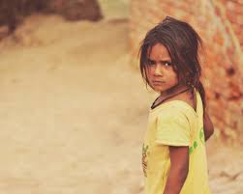
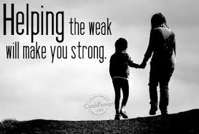
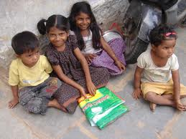

Slide 10
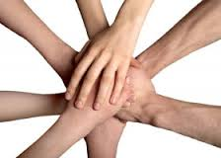
Are
we all
TOGETHER?

